Slide 1
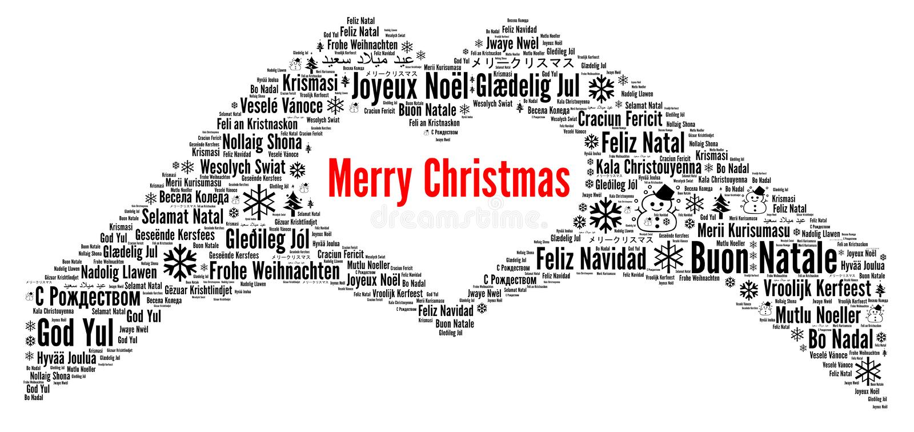
GOD JUL
MERRY CHRISTMAS

